Slide 1




Solution
Ninjas
Ticketing System
For Property Management
By : Adiba, Neha and Manav

Slide 2

Outline
Overview
User Types
DFD
ERD
Entities
Views/SP/UDF
Tools/Technologies
Future Enhancements

Slide 3

Overview
A flexible system to create, manage and report on queries and complaints for a Housing Estate.
Ninja technique to solve your problem

Slide 4
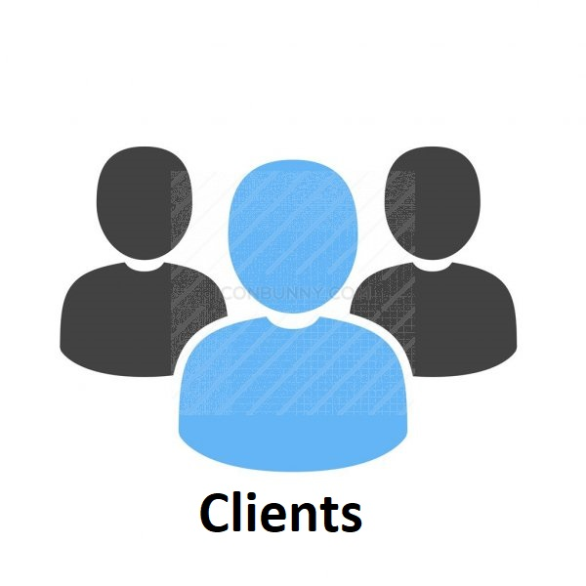


User Types
Users who raise the ticket/complain
Users who pick and solve the ticket raised in their department
Manages whole system, assigns ticket to Employee and generate reports

Slide 5
Client Functionalities
Create/raised new ticket
Upload the images inside the ticket
Track the ticket progress
Cancel/modify the ticket if it has not been assigned yet
Reach to support desk for any queries (mail to admin)

Slide 6
Employees Functionalities
Assign ticket to himself
View the list of all raised tickets and show who assigned to it.
Solve the ticket and Modify/change the status of ticket accordingly

Slide 7
Admin Functionalities
Generate time/status/department/manager/user oriented reports
Assign a Ticket to department employees
Provide support desk for client
Search any keyword to view any profile
Add/Update/Delete Departments/Properties/Users/Employees

Slide 8
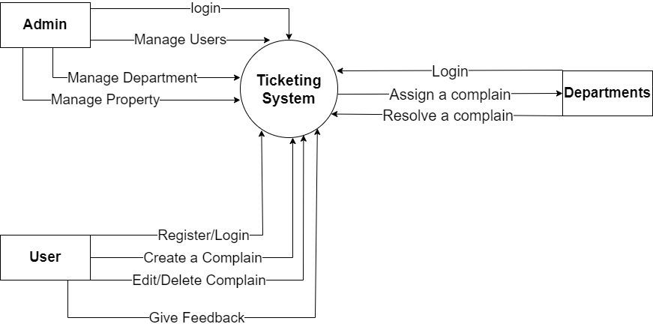

Data Flow Diagram
Level 0 | Context Level DFD

Slide 9
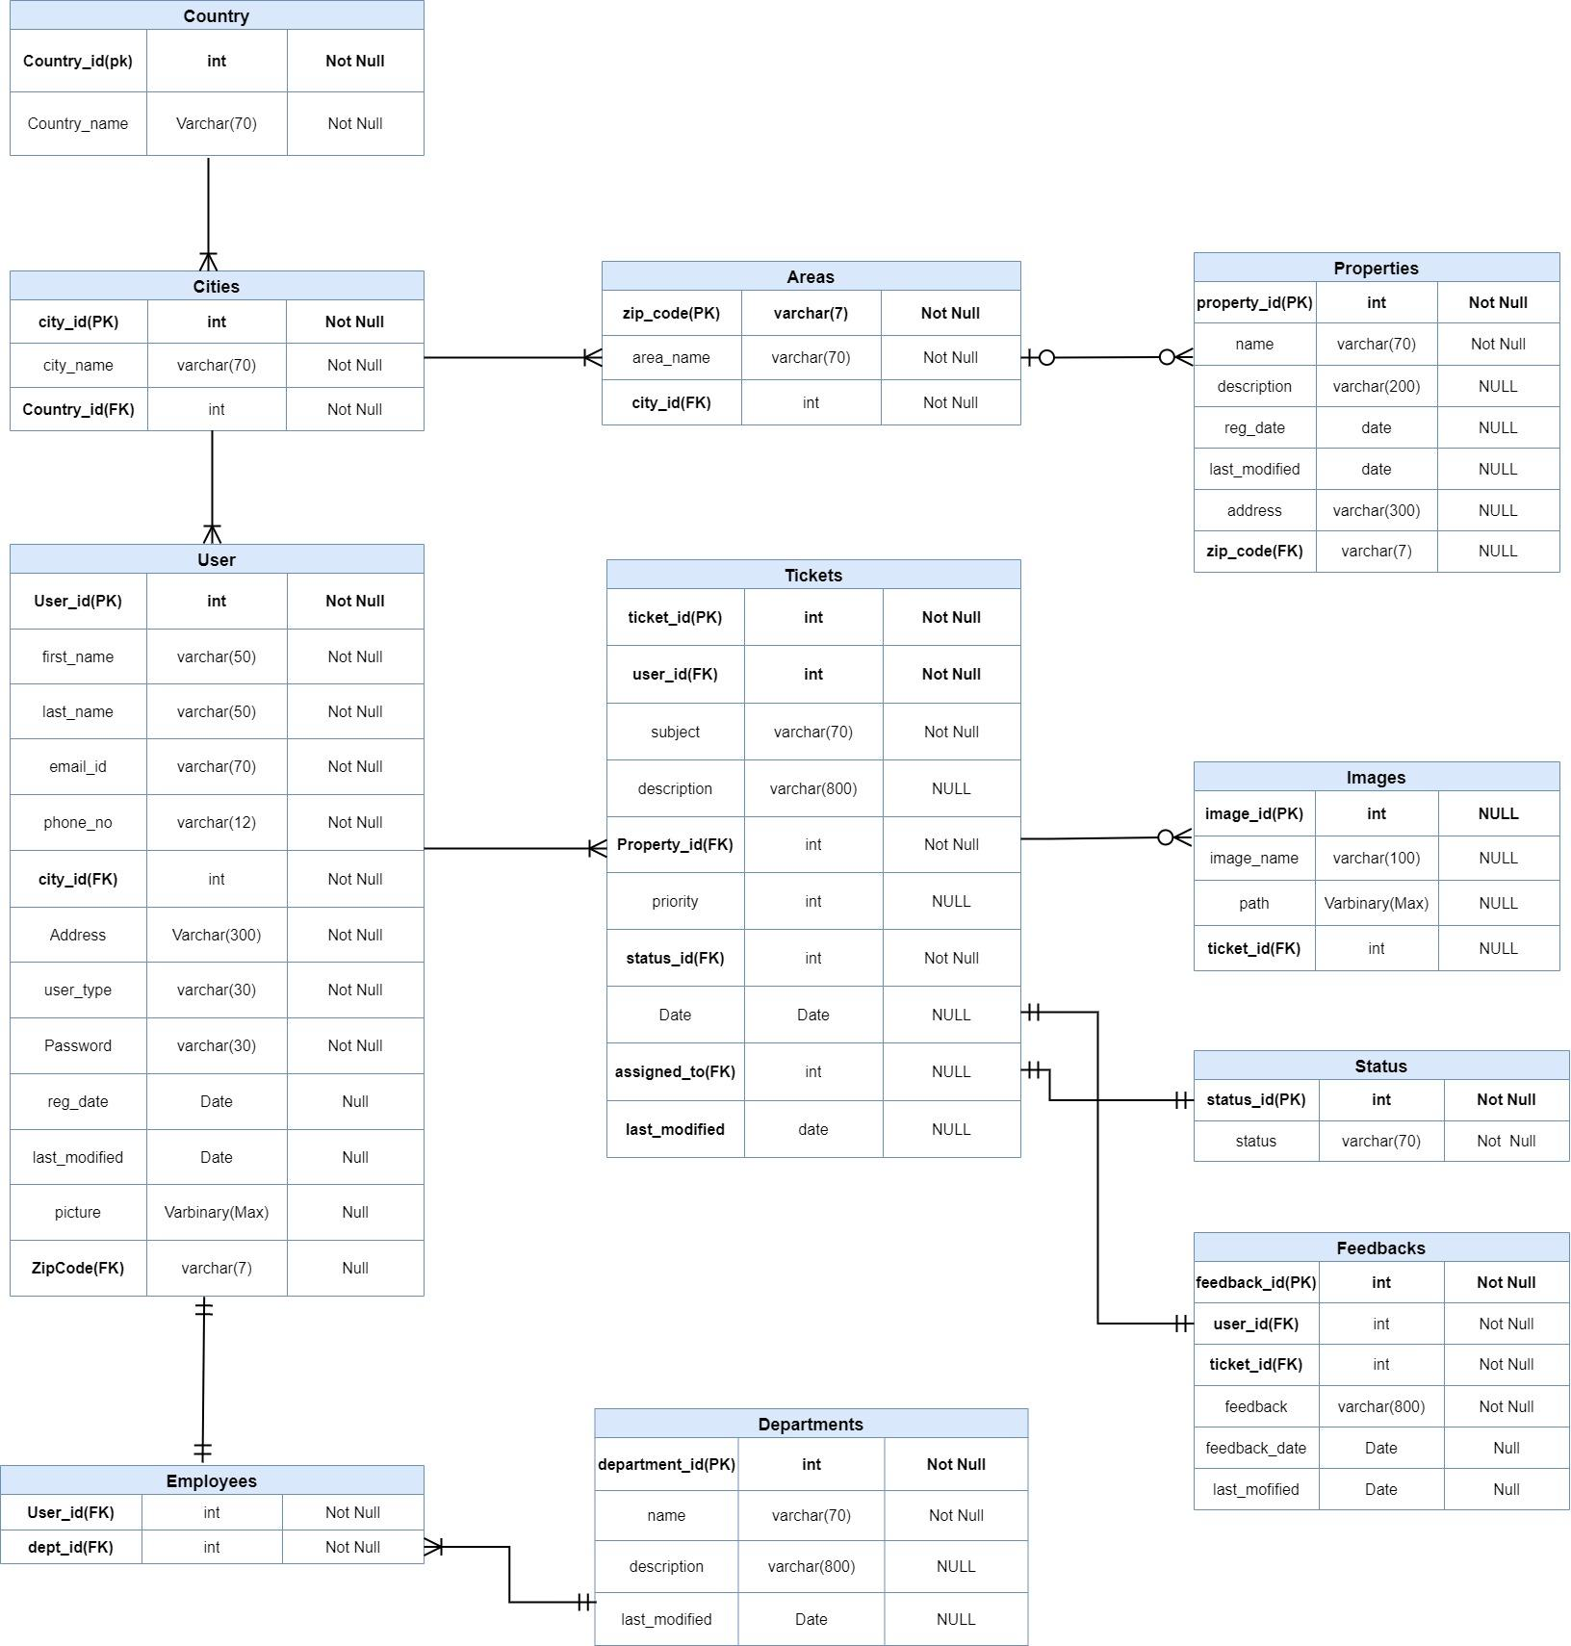
Entity Relationship Diagram
ERD : https://github.com/adibagit/Ticketing-System

Slide 10
Entities
Let us have a look at our all possible entities
With populated dummy data

Slide 11
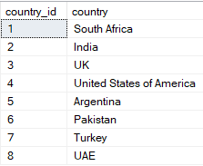
Entity - Countries
SELECT * FROM Countries

Slide 12
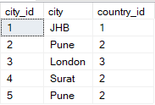
Entity - Cities
SELECT * FROM Cities

Slide 13
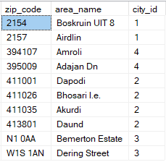
Entity - Areas
SELECT * FROM Areas

Slide 14
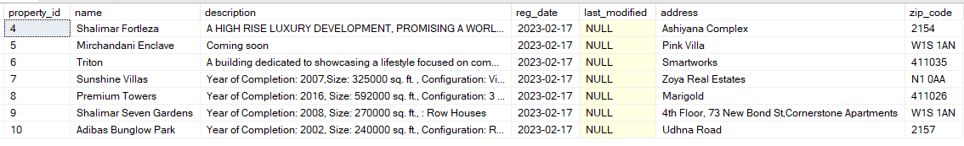
Entity - Properties
SELECT * FROM Properties

Slide 15
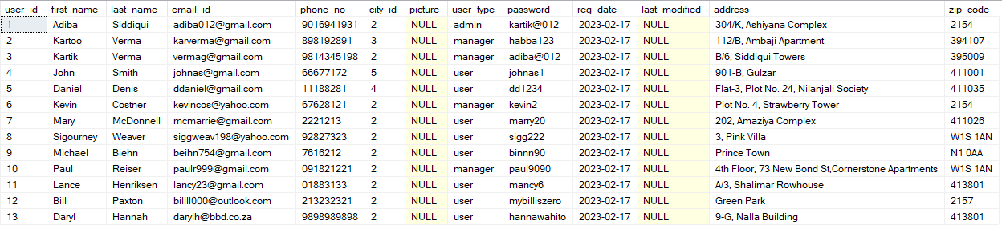
Entity - Users
SELECT * FROM Users

Slide 16
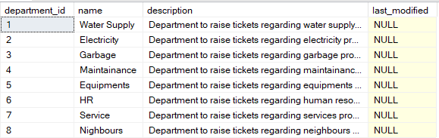
Entity - Departments
SELECT * FROM Departments

Slide 17
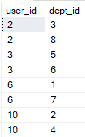
Entity - Employees
SELECT * FROM Employees

Slide 18
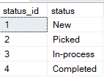
Entity - Status
SELECT * FROM Status

Slide 19
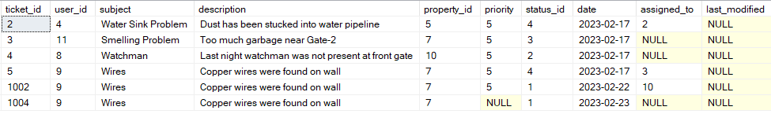
Entity - Tickets
SELECT * FROM Tickets

Slide 20
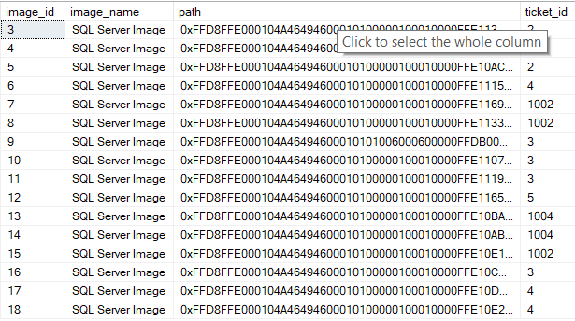
Entity - Images
SELECT * FROM Images

Slide 21
Entity - Feedbacks
SELECT * FROM Feedbacks

Slide 22
Views/
Stored Procedures/
User Defined Functions
Let us have a look at our all user defined entities and reports
With populated dummy data

Slide 23
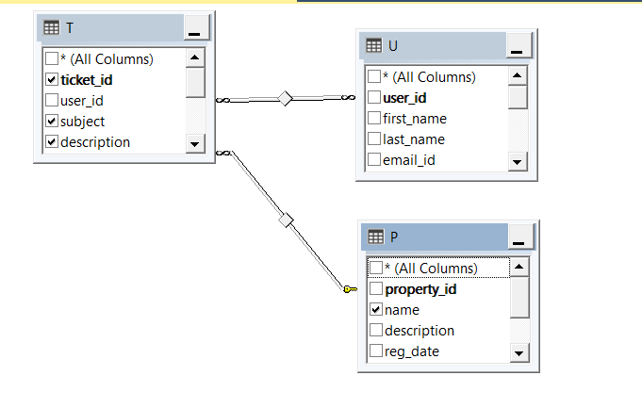
Views
01
1
Report of all the tickets which are solved
Joined 3 tables with Tickets Table :
Users and Properties

Slide 24
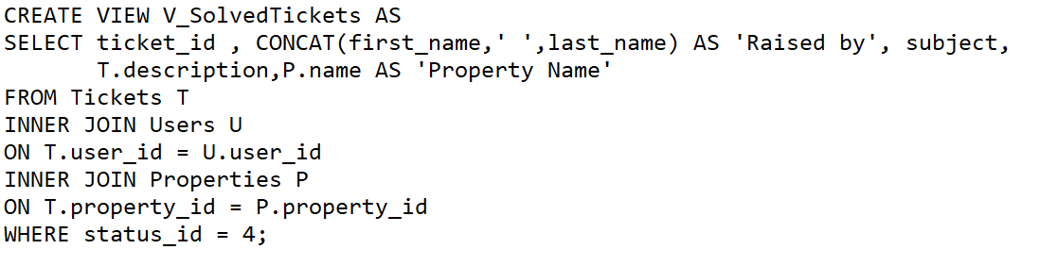
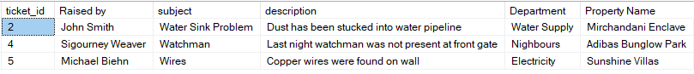
View - V_SolvedTickets
SELECT * FROM V_SolvedTickets

Slide 25
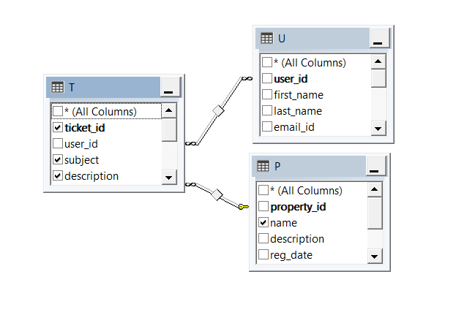
Views
02
1
Report of all the tickets which are pending
Joined 3 tables with Tickets Table :
Users and Properties

Slide 26
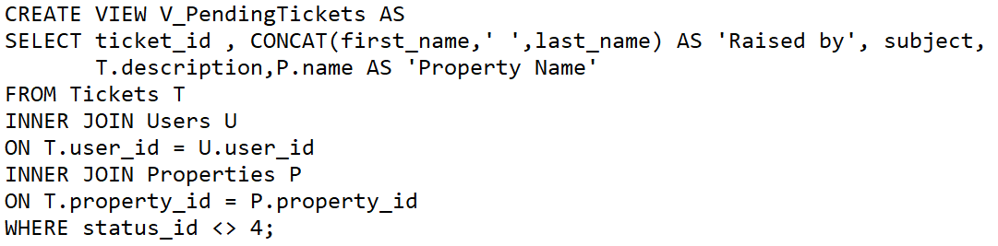
View - V_PendingTickets
SELECT * FROM V_PendingTickets

Slide 27
Stored Procedures
01
1
P_RAISE_TICKET
A procedure to raise a ticket, providing essential attributes.

Slide 28
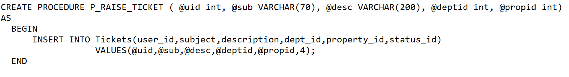
SP - P_RAISE_TICKET
The ticket will be created and a row will be inserted in Tickets table
EXEC P_RAISE_TICKET 9, 'Wires ' , 'Copper wires were found on wall', 2, 7;

Slide 29
Stored Procedures
02
1
P_USERUPDATE
A procedure to update user’s various details.

Slide 30
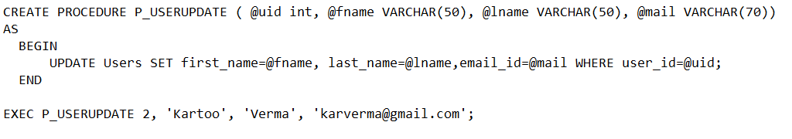
SP - P_USERUPDATE
The row matching mentioned user_id will be affected in Users table
EXEC P_USERUPDATE 2, 'Kartoo', 'Verma', 'karverma@gmail.com';

Slide 31
User Defined Functions
01
1
GetUnsolvedTicketsCount()
This function will return the count of the tickets whose status is other than solved.

Slide 32
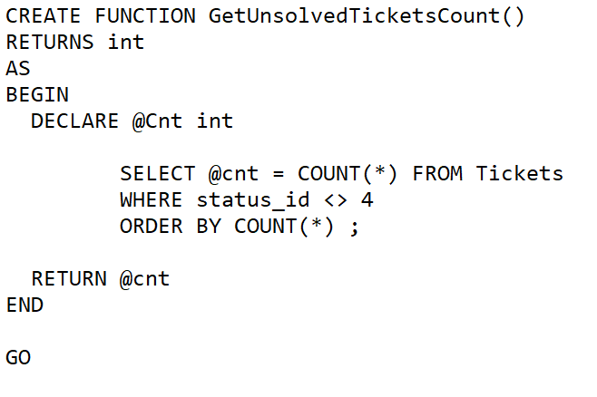
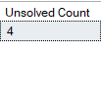
UDF - GetUnsolvedTicketsCount()
SELECT dbo.GetUnsolvedTicketsCount() AS 'Unsolved Count';

Slide 33
User Defined Functions
02
1
GetManagers()
This function will display details of all the users who are managers.

Slide 34
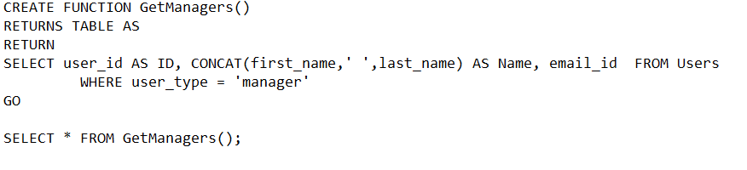
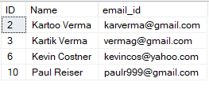
UDF - GetManagers()
SELECT * FROM GetManagers();

Slide 35

Tools/
Technologies
Front-end Tech:
ReactJS
Back-end Tech:
Java Spring Boot/ NodeJS
Database :
Microsoft SQL Server
Tools/IDEs:
Visual Studio Code
Eclipse
SQL Server Management Studio 19

Slide 36
Future
Enhancements
Notifications
Comment Section
Team Collaboration
AWS S3 Bucket

Slide 37
Thank You
https://github.com/adibagit/Ticketing-System/
Adiba Siddiqui

